Slide 1
Movement Disorders

Slide 2
Movement Disorders

Slide 3
Movement Disorders
too much
too little

Slide 4
Movement Disorders
too much - involuntary movements
too little - bradykinesias
  akinetic - rigid syndromes

Slide 5
involuntary movements
tremor
chorea, athetosis
hemiballismus
dystonia
myoclonus
tics

Slide 6
Parkinsonism

Slide 7
Parkinsonism
What is Parkinsonism?

Slide 8
Parkinsonism
TRAP
  tremor
  rigidity
  akinesia
  postural instability

Slide 9
What type of Parkinsonism?
Idiopathic - Parkinson’s disease
Secondary Parkinsonism
Parkinsonism - Plus syndromes

Slide 10
Secondary Parkinsonism
Parkinsonism due to underlying cause
poor response to levodopa

Slide 11
Secondary Parkinsonism - causes
drug induced
vascular / arteriosclerotic
metabolic / toxic
  Wilson’s disease, …
post encephalitic
repeated head injury
hydrocephalus

Slide 12
Parkinsonism Plus Syndromes
Parkinsonism + other features
autonomic
pyramidal
cerebellar
poor response to levodopa

Slide 13
Parkinsonism Plus Syndromes
Multiple system atrophy
Progressive supranuclear palsy
Cortico-basal ganglionic degeneration
Diffuse Lewy body disease

Slide 14
Is it Parkinson’s disease?

Slide 15
Is it Parkinson’s disease?
TRAP
  bradykinesia + one of tremor, rigidity, postural instability
unilateral onset
upper limb onset
persistent asymmetry
good response to levodopa

Slide 16
Is it Parkinson’s disease?
bradykinesia - ‘poverty of movement’
  slow - movements, speech ‘mask-like’, reduced arm swing, writing
tremor - rest - ‘pill-rolling’, postural
rigidity - cog wheel
posture - instability - falls, stooped
gait - festinant, narrow base, shuffling

Slide 17
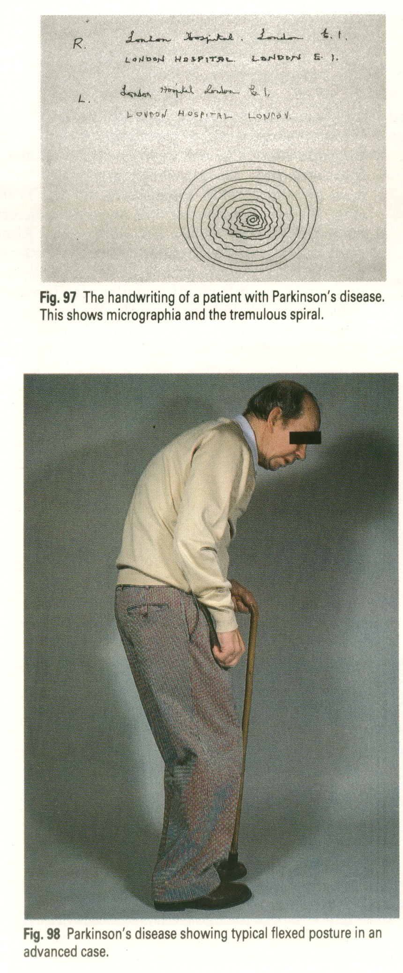

Slide 18
Treatment of PD

Slide 19
Treatment of PD
levodopa + carbidopa/ benserazide
dopamine agonists
anticholinergics
selegiline
amantadine
COMT inhibitors - entacapone

Slide 20
Treatment of PD - levodopa
mainstay of treatment
peripheral effects -
  nausea, vomiting, postural hypotension
treatment related motor problems - after ~5 y
  motor fluctuations - freezing, wearing-off, on-off
  dyskinesias

Slide 21
Treatment of PD
no functional impairment - no treatment
functional impairment, >70 yrs - levodopa
functional impairment, <50 yrs - levodopa
  dopamine agonist anticholinergic. selegiline, amantadine

Slide 22
Surgical Treatment of PD
deep brain stimulation / lesioning
  subthalamic nucleus
  thalamus
  pallidum
foetal nigral transplants

Slide 23
Tremor

Slide 24
Tremor
rest
  parkinsonism
action/ kinetic
  postural
  task-specific
  intention - cerebellar
  rubral - midbrain

Slide 25
postural tremor
essential
familial
enhanced physiological tremor
  ……

Slide 26
postural tremor
essential
familial
enhanced physiological tremor
  stress
  drugs - beta-agonists, tricyclics, lithium, valproate, …
  endocrine - thyrotoxicosis, phaeo

Slide 27
Wilson’s disease

Slide 28
Wilson’s disease
movement disorders -
  in young people
  involuntary movements, akinetic- rigid
neuro-psychiatric changes
liver disease
haemolytic anaemia
eye - KF rings

Slide 29
Movement Disorders
too much
too little

Slide 30
Movement Disorders
too easy

